Slide 1
Why we should not use
3-D in Graphs

Slide 2
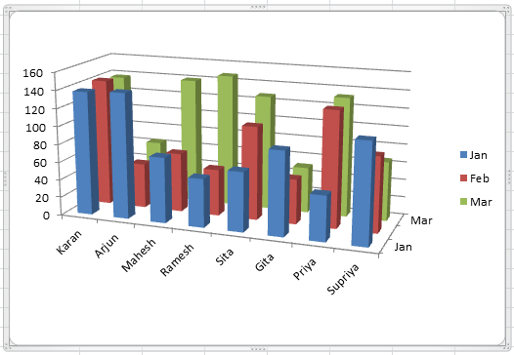
3-D ALWAYS creates Lie Factor

Slide 3
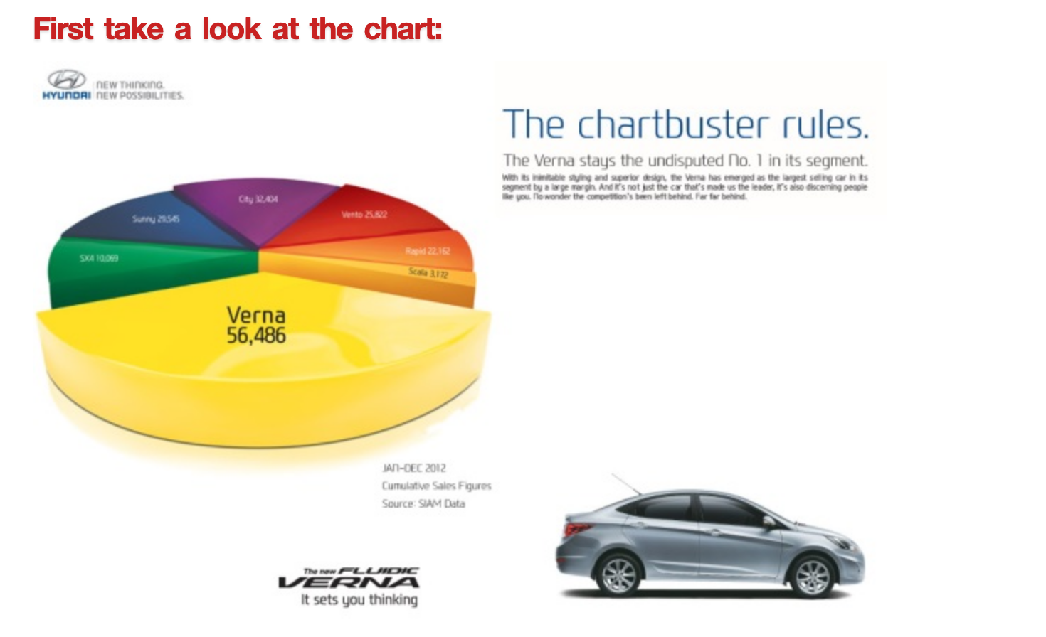
3-D ALWAYS creates Lie Factor

